Slide 1

Approximate Computing
Presented by Marvin Sevilla

Slide 2
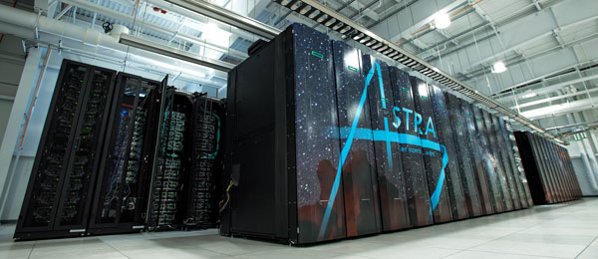
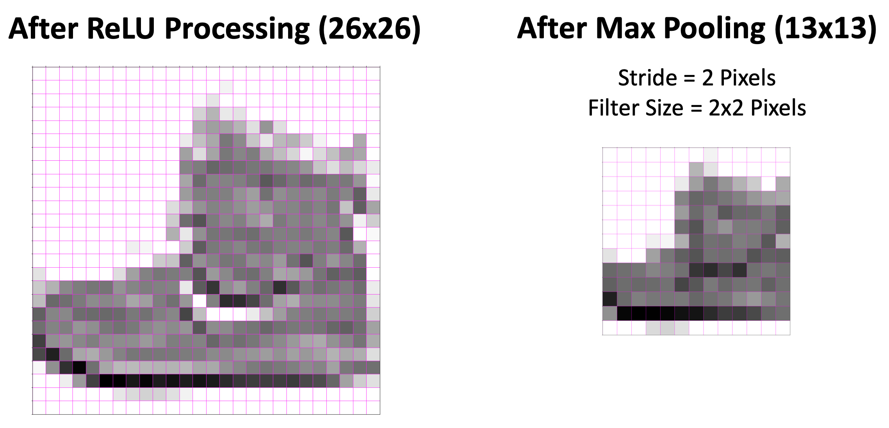
Approximate Computing
Presented by Marvin Sevilla
Overview
What is Approximate Computing
Real Life Examples
Practical Applications
Under The Hood
Image Algorithm Demo
Practical Coding Demo
Closing Remarks

Slide 3
Approximate Computing
Presented by Marvin Sevilla
Overview
What is Approximate Computing
Real Life Examples
Practical Applications
Under The Hood
Image Algorithm Demo
Practical Coding Demo
Closing Remarks
What is Approximate Computing?
A technique for achieving a satisfactory computational result with reliable and controllable error thresholds, yielding computationally faster algorithms that use less energy at the expense of lower quality results with negligible error

Slide 4
Overview
What is Approximate Computing
Real Life Examples
Practical Applications
Under The Hood
Image Algorithm Demo
Practical Coding Demo
Closing Remarks
What is Approximate Computing?
A technique for achieving a satisfactory computational result with reliable and controllable error thresholds, yielding computationally faster algorithms that use less energy at the expense of lower quality results with negligible error

Slide 5
What is Approximate Computing?
A technique for achieving a satisfactory computational result with reliable and controllable error thresholds, yielding computationally faster algorithms that use less energy at the expense of lower quality results with negligible error
Levels of Approximate Computing
Logic & Circuit
Microarchitecture (atomic functions)
Algorithms
Parameters

Slide 6
What is Approximate Computing?
It is undeniably faster and lower-power as it is unreliable
Domains of Approximate Computing
Logic & Circuit
Microarchitecture (atomic functions)
Algorithms
Parameters

Slide 7
What is Approximate Computing?
Domains of Application for Approximate Computing
Logic & Circuit
Microarchitecture (atomic functions)
Algorithms
Parameters
Parts of Every Approximate Computing Technique
Error Occurrence
Degradation
Level
Evaluation
It is undeniably faster and lower-power as it is unreliable

Slide 8
What is Approximate Computing?
Parts of Every Approximate Computing Technique
Error Occurrence
Degradation
Level
Evaluation
Error Occurrence Degradation Level Evaluation
Domains of Application for Approximate Computing
Logic & Circuit
Microarchitecture (atomic functions)
Algorithms
Parameters
Errors can be either non-deterministic or deterministic
Non-Deterministic: happens randomly
Deterministic: able to consistently reproduce the same error

Slide 9
What is Approximate Computing?
Error Occurrence Degradation Level Evaluation
Parts of Every Approximate Computing Technique
Error Occurrence
Degradation
Level
Evaluation
Errors can be either non-deterministic or deterministic
Non-Deterministic: happens randomly
Deterministic: able to consistently reproduce the same error
Focuses on error rates and outcomes
Error Rate: The frequency and magnitude of errors (toggle-able or gradual degradation)
Error Outcomes: Can either be Bounded (Toggleable), Catastrophic (Toggleable and Gradual) or Graceful (Gradual)

Slide 10
What is Approximate Computing?
Error Occurrence Degradation Level Evaluation
Focuses on error rates and outcomes
Error Rate: The frequency and magnitude of errors (toggle-able or gradual degradation)
Error Outcomes: Can either be Bounded (Toggleable), Catastrophic (Toggleable and Gradual) or Graceful (Gradual)
Three Different Levels:
Transistor
Logic
Algorithmic

Slide 11
What is Approximate Computing?
Error Occurrence Degradation Level Evaluation
Three Different Levels:
Transistor
Logic
Algorithmic
Focuses on error rates and outcomes
Error Rate: The frequency and magnitude of errors (toggle-able or gradual degradation)
Error Outcomes: Can either be Bounded (Toggleable), Catastrophic (Toggleable and Gradual) or Graceful (Gradual)
Evaluation of approximate computing techniques from an atomic or application point-of-view

Slide 12
What is Approximate Computing?
Error Occurrence Degradation Level Evaluation
The ultimate success of an approximated application is its reliability
Reliability looks like executing the process multiple times, and the end-state of the relaxed version matches the original version a specified number of times, we deem the program reliable to that point
Evaluation of approximate computing techniques from an atomic or application point-of-view
Three Different Levels:
Transistor
Logic
Algorithmic

Slide 13
What is Approximate Computing?
The ultimate success of an approximated application is its reliability
Reliability looks like executing the process multiple times, and the end-state of the relaxed version matches the original version a specified number of times, we deem the program reliable to that point
Evaluation of approximate computing techniques from an atomic or application point-of-view

Slide 14
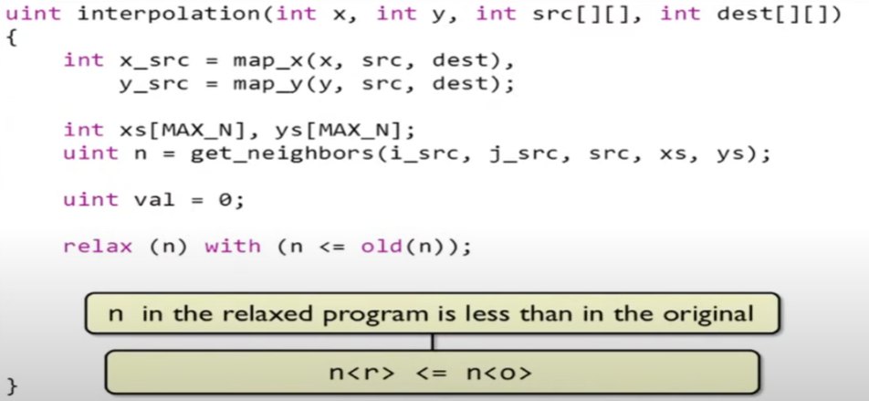
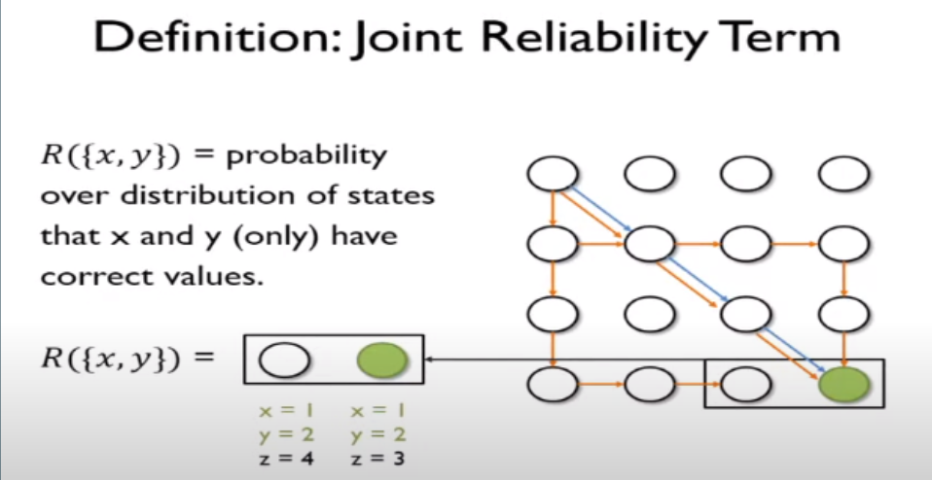
What is Approximate Computing?

Slide 15
Practical Application
What is Approximate Computing?
Approximation does not have to be a fixed feature in the system.
How Can You Use Approximate Computing Techniques?

Slide 16
Practical Application
What is Approximate Computing?
Approximation does not have to be a fixed feature in the system.
How Can You Use Approximate Computing Techniques?
Practical Application
Such as Code Perforation (e.g. Loops), Function Substitution, Approximate Memoization, Relaxed Synchronization, Approximate Hardware

Slide 17
Practical Application
How Can You Use Approximate Computing Techniques?
Practical Application
Such as Code Perforation (e.g. Loops), Function Substitution, Approximate Memoization, Relaxed Synchronization, Approximate Hardware
Choosing between the use of single and half precision numbers

Slide 18
Practical Application
How Can You Use Approximate Computing Techniques?
Practical Application
Such as Code Perforation (e.g. Loops), Function Substitution, Approximate Memoization, Relaxed Synchronization, Approximate Hardware
Choosing between the use of single and half precision numbers

Slide 19
Practical Application
How Can You Use Approximate Computing Techniques?
Practical Application
Such as Code Perforation (e.g. Loops), Function Substitution, Approximate Memoization, Relaxed Synchronization, Approximate Hardware
Choosing between the use of single and half precision numbers
A difference of ~3 Bytes/13 bits
An ALU that concludes 2+2 = 6 or Secondary memory that interprets memory location 0x3452 as 13394 in decimal, but retrieves memory location 40

Slide 20
Practical Application
Choosing between the use of single and half precision numbers
A difference of ~3 Bytes/13 bits
Such as Code Perforation (e.g. Loops), Function Substitution, Approximate Memoization, Relaxed Synchronization, Approximate Hardware
An ALU that concludes 2+2 = 6 or Secondary memory that interprets memory location 0x3452 as 13394 in decimal, but retrieves memory location 40
Voltage Scaling + Dynamic Voltage and Frequency Scaling (DVFS)

Slide 21
Practical Application
Such as Code Perforation (e.g. Loops), Function Substitution, Approximate Memoization, Relaxed Synchronization, Approximate Hardware
Voltage Scaling + Dynamic Voltage and Frequency Scaling (DVFS)
Error Resilient Algorithms
An ALU that concludes 2+2 = 6 or Secondary memory that interprets memory location 0x3452 as 13394 in decimal, but retrieves memory location 40
Reducing the operating voltage of the processor, going even as far as adjusting the voltage dynamically based on the input/workload

Slide 22
Practical Application
Voltage Scaling + Dynamic Voltage and Frequency Scaling (DVFS)
Error Resilient Algorithms
Application Approximation
Like the Newton-Raphson method, lossy compression (e.g. JPEGs), or sorting algorithms like TeraSort

Slide 23
Practical Application
Error Resilient Algorithms
Application Approximation
Quality-Aware Programming
Instead of approximating the entire application, approximate only parts of it and grant the rest higher levels of accuracy

Slide 24
Practical Application
Application Approximation
Quality-Aware Programming
A programming tactic which requires that software developers be keenly aware and constantly attempting to reduce a program’s space complexity
E.g. Datatype consideration

Slide 25
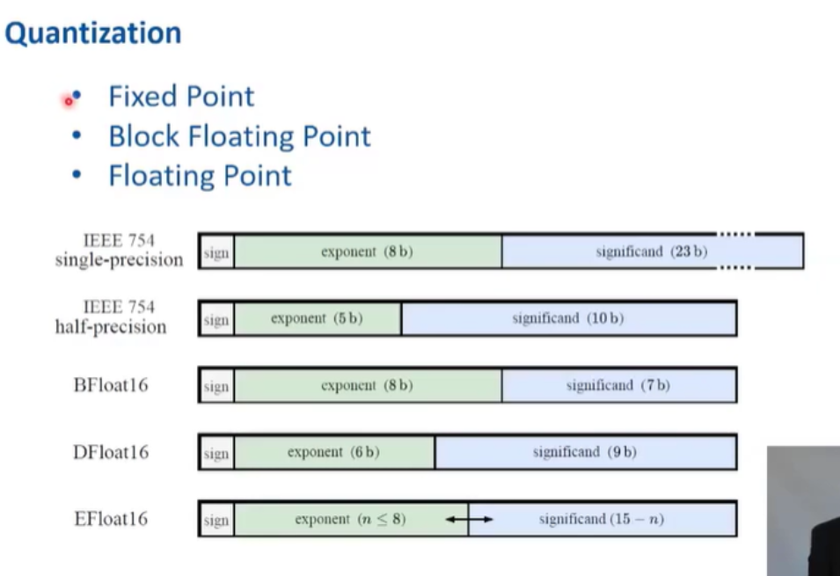
Real Life Examples
Practical Application
Application Approximation
Where is Approximate Computing Used Right Now?

Slide 26
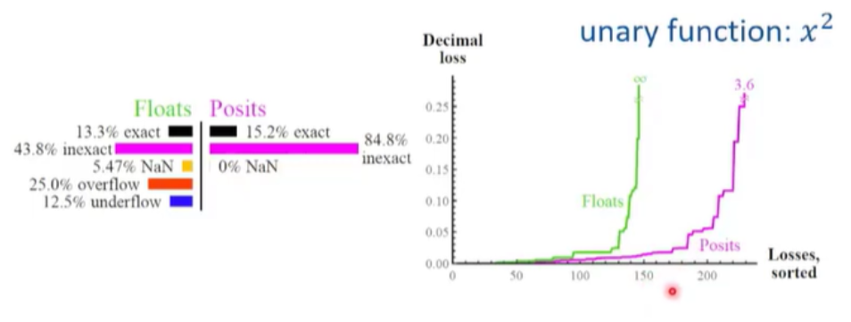
Real Life Examples
Practical Application
Application Approximation
Where is Approximate Computing Used Right Now?

Slide 27
Real Life Examples
Practical Application
Where is Approximate Computing Used Right Now?
Soft Examples
Generally used to meet project budget or time requirements
Fixed point, block floating point, floating point, and posit-representation

Slide 28
Real Life Examples
Where is Approximate Computing Used Right Now?
Practical Application
Soft Examples
Generally used to meet project budget or time requirements
Fixed point, block floating point, floating point, and posit-representation
Concrete Examples
Helps computing clusters used for deep-learning reduce energy consumption and cost associated with IC-density
"...approximate computing techniques need to exploit the error-tolerance of humans and neural networks. This optimization can lead to lightweight neural networks." (21, Srivastava, Srishti, et al. "A Survey of Deep Learning Techniques for Vehicle Detection from UAV Images." CSE Department, IIT Dharwad, India, ECE Department, NIT Trichy, India, ECE Department, IIT Roorkee, India, 2024.)

Slide 29
Soft Examples
Generally used to meet project budget or time requirements
Fixed point, block floating point, floating point, and posit-representation
Concrete Examples
Helps computing clusters used for deep-learning reduce energy consumption and cost associated with IC-density
"...approximate computing techniques need to exploit the error-tolerance of humans and neural networks. This optimization can lead to lightweight neural networks." (21, Srivastava, Srishti, et al. "A Survey of Deep Learning Techniques for Vehicle Detection from UAV Images." CSE Department, IIT Dharwad, India, ECE Department, NIT Trichy, India, ECE Department, IIT Roorkee, India, 2024.)

Slide 30
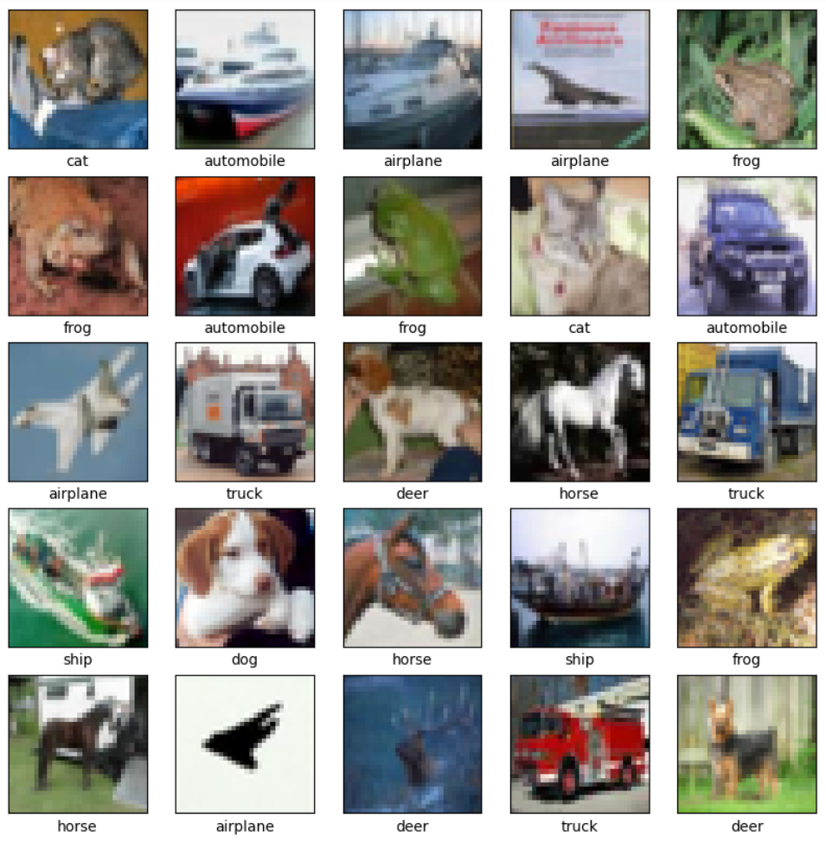
Concrete Examples
"...approximate computing techniques need to exploit the error-tolerance of humans and neural networks. This optimization can lead to lightweight neural networks."
(21, Srivastava, Srishti, et al. "A Survey of Deep Learning Techniques for Vehicle Detection from UAV Images." CSE Department, IIT Dharwad, India, ECE Department, NIT Trichy, India, ECE Department, IIT Roorkee, India, 2024.)
Max Pooling

Slide 31
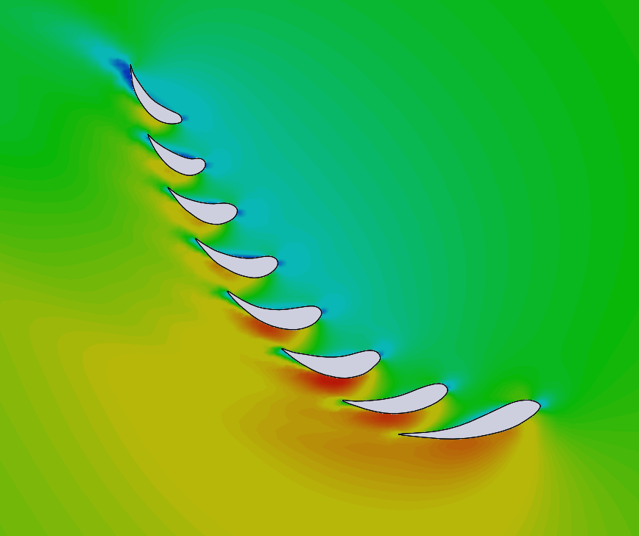
Concrete Examples
"...approximate computing techniques need to exploit the error-tolerance of humans and neural networks. This optimization can lead to lightweight neural networks."
(21, Srivastava, Srishti, et al. "A Survey of Deep Learning Techniques for Vehicle Detection from UAV Images." CSE Department, IIT Dharwad, India, ECE Department, NIT Trichy, India, ECE Department, IIT Roorkee, India, 2024.)
Max Pooling
ANSYS Mesh

Slide 32
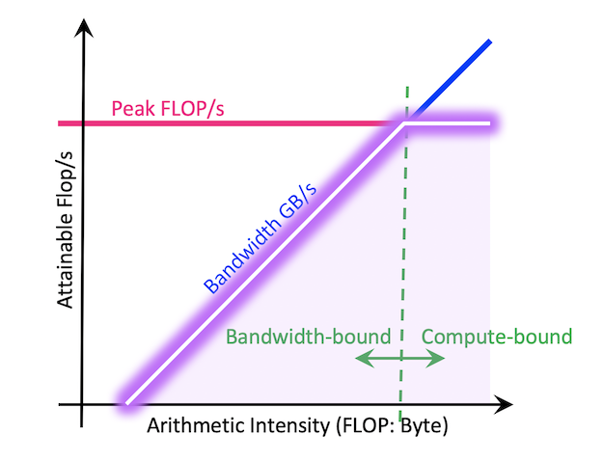
Concrete Examples
Max Pooling
ANSYS Mesh
Single v. Double Precision GPU Computation
With Roofline Graph

Slide 33
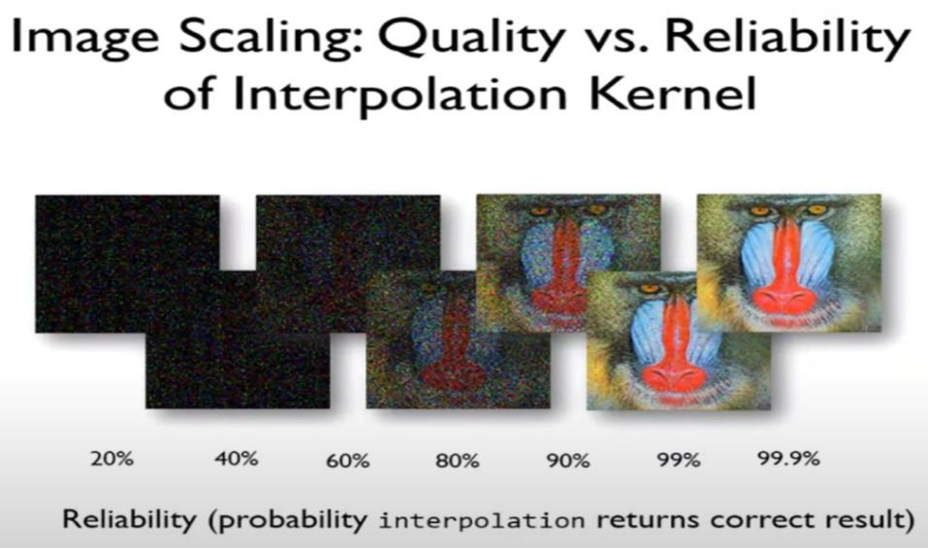
Concrete Examples
ANSYS Mesh
Single v. Double Precision GPU Computation
With Roofline Graph
Image Compression

Slide 34
Under The Hood
Concrete Examples
How Does Approximate Computing Generally Work?
Single v. Double Precision GPU Computation
With Roofline Graph
Image Compression

Slide 35
Under The Hood
Concrete Examples
How Does Approximate Computing Generally Work?
Image Compression
General Steps
Achieve Minimal Error Result
Establish a Safe Execution Envelope
Relax the Semantics of the Program
Verify the Program’s Result

Slide 36
Under The Hood
How Does Approximate Computing Generally Work?
General Steps
Achieve Minimal Error Result
Establish a Safe Execution Envelope
Relax the Semantics of the Program
Verify the Program’s Result

Slide 37
General Steps
Establish a Safe Execution Envelope
Achieve Minimal Error Result
Develop quantitative verification systems
Utilize error-resilient domains
Human Perception
Data Redundancy
Generally, areas with “no golden result”
Relax the Semantics of the Program
Verify the Program’s Result

Slide 38
General Steps
Relax the Semantics of the Program
Establish a Safe Execution Envelope
Achieve Minimal Error Result
Prominent concerns with radically inaccurate results, rarely correct results, crashes or other malicious actions
Mitigated via error bounding, for example, using assertions (e.g. a / b such that b ≠ 0, where b≠0 is the assertion)

Slide 39
General Steps
Verify the Program Result
Relax the Semantics of the Program
Establish a Safe Execution Envelope
If the relaxed version of a program is different to the original, when will they converge? When can they be related again?
There are synchronization points where the 2 converge
We bring the assertion or result to a previous (or sometimes future) synchronization point and verify it there
Verification reuses existing reasoning from the original program
Languages such as Coq analyze raw source code using user-given inference rules to validate logic

Slide 40
General Steps
Verify the Program Result
Relax the Semantics of the Program
End performance can be measured via things like data processing and feature extraction
Data processing refers to the quality of filtering, compression, or equivalent action which can be measured by human perception
Feature extraction refers to the identification of properties or characteristics of a data instance using algorithms/methods
All operations’ reliabilities are evaluated (reading, arithmetic, etc.)

Slide 41
General Steps
Verify the Program Result
Put junk in, get junk out

Slide 42
General Steps
Verify the Program Result
Example of Quantified Reliability
.99 * R(x,y,src,dest) <= rd(val) * op(*.) * R(val)
In English:
The Specified Bound * Reliability of Operation <= the probability we read the value right * the probability the operand performs right * the probability that the input value itself is right

Slide 43
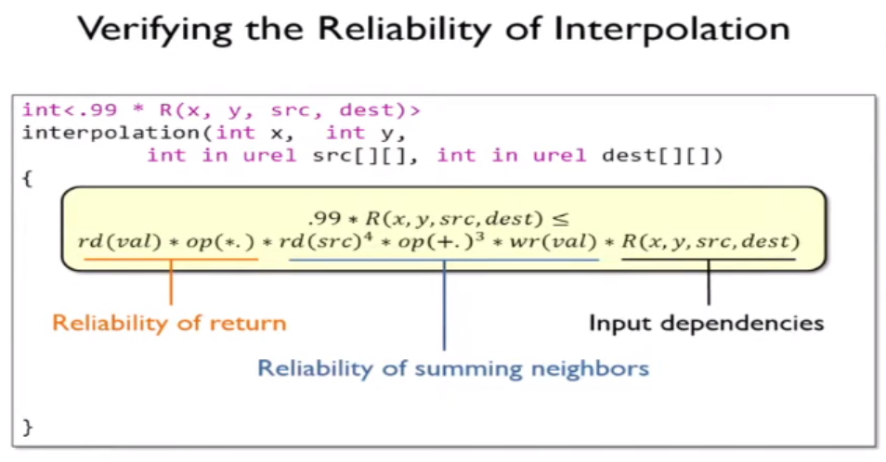
General Steps
Verify the Program Result

Slide 44
Image Algorithm Demo
Image Compression via Max Pooling

Slide 45
Practical Coding Demo
How Datatype Choice Affects Performance

Slide 46
Closing Thoughts
Key Takeaways for Your Computer Science Journey
Closing Thoughts
Probability operations must stay within the established acceptable error threshold
Computations must still meet reliability requirements which can be ensured using error detection and correction mechanisms or algorithmic adjustments that compensate for potential errors
Error-tolerant software must be tested, validated, or verified at an appropriate frequency to ensure reliable results despite the uncertainties introduced by the computer’s hardware or lower-level processes

Slide 47
Questions?
Closing Thoughts
Probability operations must stay within the established acceptable error threshold
Computations must still meet reliability requirements which can be ensured using error detection and correction mechanisms or algorithmic adjustments that compensate for potential errors
Error-tolerant software must be tested, validated, or verified at an appropriate frequency to ensure reliable results despite the uncertainties introduced by the computer’s hardware or lower-level processes

Slide 48
Questions?
Closing Thoughts
Probability operations must stay within the established acceptable error threshold
Computations must still meet reliability requirements which can be ensured using error detection and correction mechanisms or algorithmic adjustments that compensate for potential errors
Error-tolerant software must be tested, validated, or verified at an appropriate frequency to ensure reliable results despite the uncertainties introduced by the computer’s hardware or lower-level processes

